Slide 1
Basic concepts
Networks must be able to transfer data from one device to another with complete accuracy.
Data can be corrupted during transmission.
For reliable communication, errors must be detected and corrected.
Error detection and correction are implemented either at the data link layer or the transport layer of the OSI model.

Slide 2
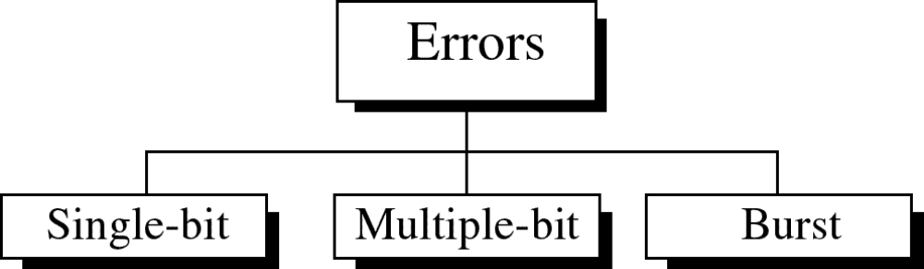
Types of Errors

Slide 3
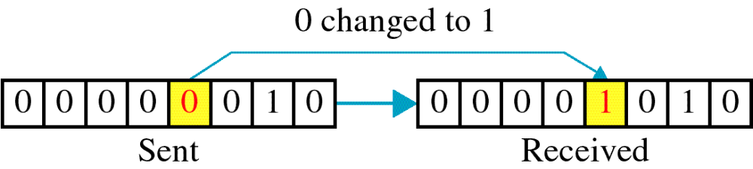
Single-bit error

Slide 4
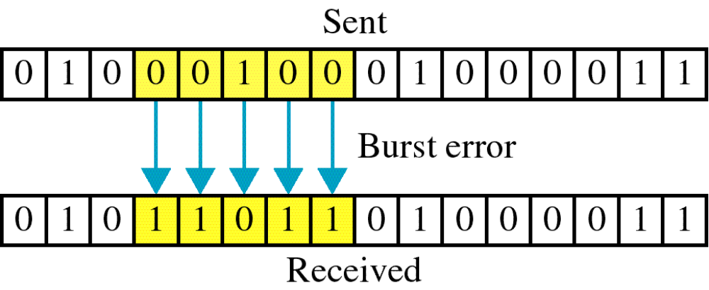
Burst error

Slide 5
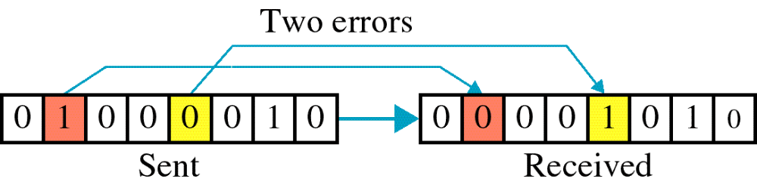

Slide 6
The term burst error means that two or more bits in the data unit have changed from 1 to 0 or from 0 to 1.
Burst errors does not necessarily mean that the errors occur in consecutive bits, the length of the burst is measured from the first corrupted bit to the last corrupted bit. Some bits in between may not have been corrupted.

Slide 7
Error detection
Error detection means to decide whether the received data is correct or not without having a copy of the original message.
Error detection uses the concept of redundancy, which means adding extra bits for detecting errors at the destination.
Notes:
Make sense of message.
Make sense of message.

Slide 8
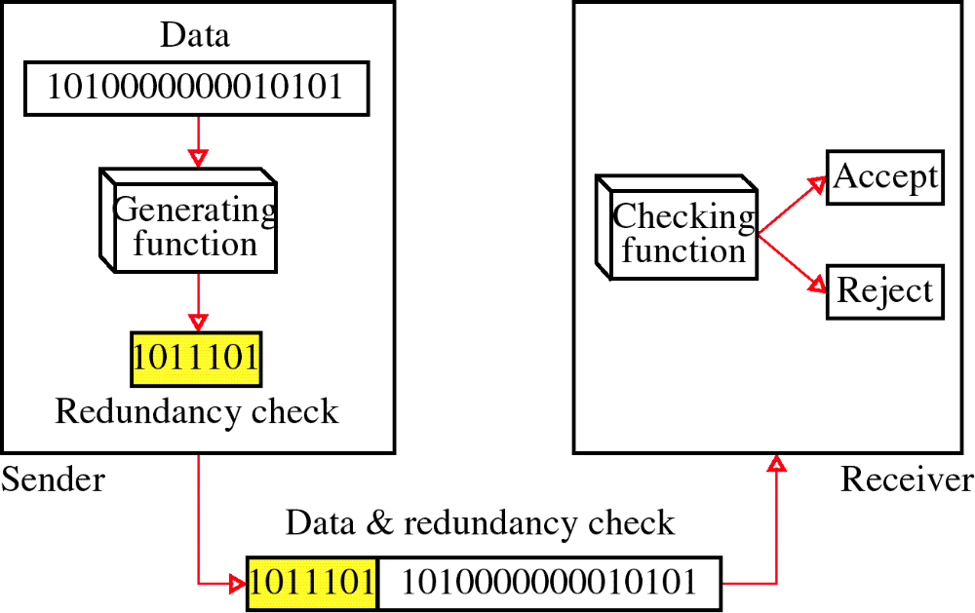
Redundancy

Slide 9
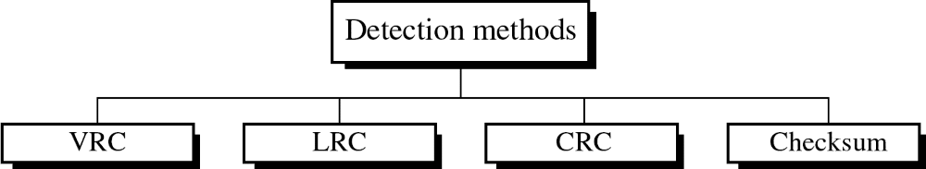
Four types of redundancy checks are used
in data communications

Slide 10
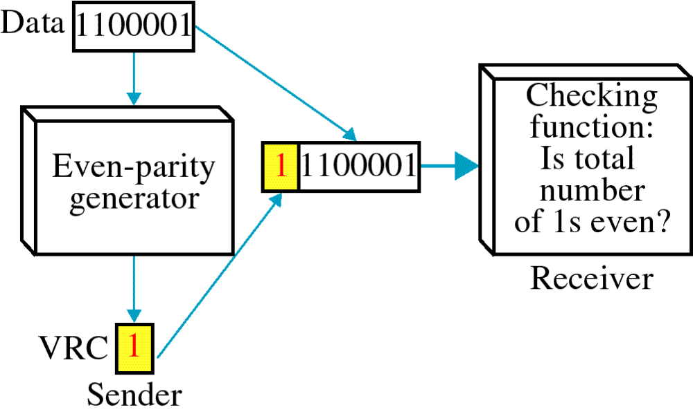
Vertical Redundancy Check
VRC

Slide 11
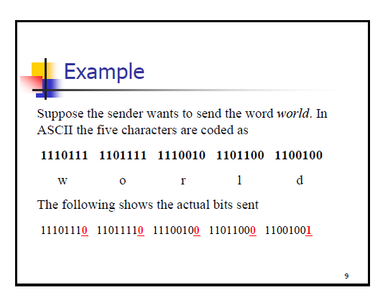

Slide 12
Performance
It can detect burst errors only if the total number of errors is odd.

Slide 13
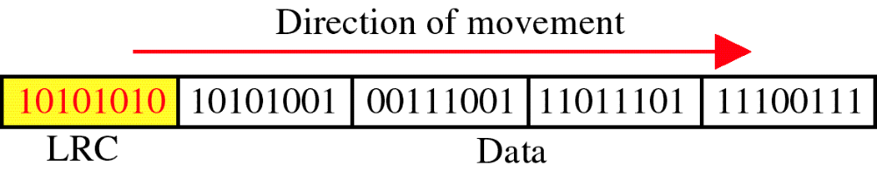
Longitudinal Redundancy Check
LRC

Slide 14
Performance
LCR increases the likelihood of detecting burst errors.
If two bits in one data units are damaged and two bits in exactly the same positions in another data unit are also damaged, the LRC checker will not detect an error.

Slide 15
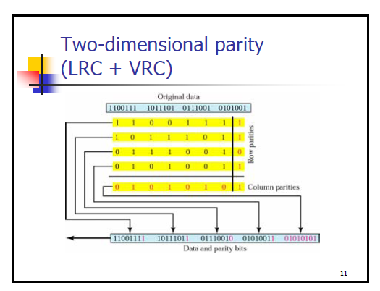

Slide 16
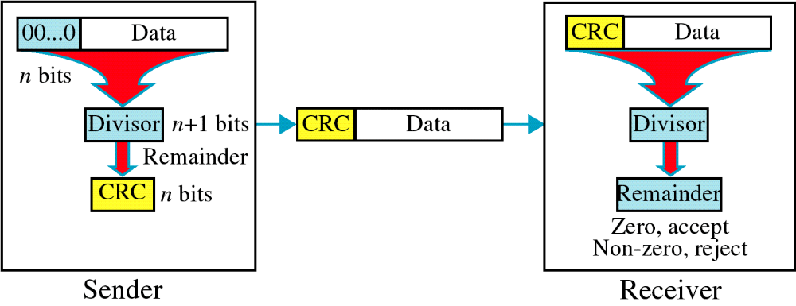
Cyclic Redundancy Check
CRC

Slide 17
Cyclic Redundancy Check
Given a k-bit frame or message, the transmitter generates an n-bit sequence, known as a frame check sequence (FCS), so that the resulting frame, consisting of (k+n) bits, is exactly divisible by some predetermined number.
The receiver then divides the incoming frame by the same number and, if there is no remainder, assumes that there was no error.

Slide 18
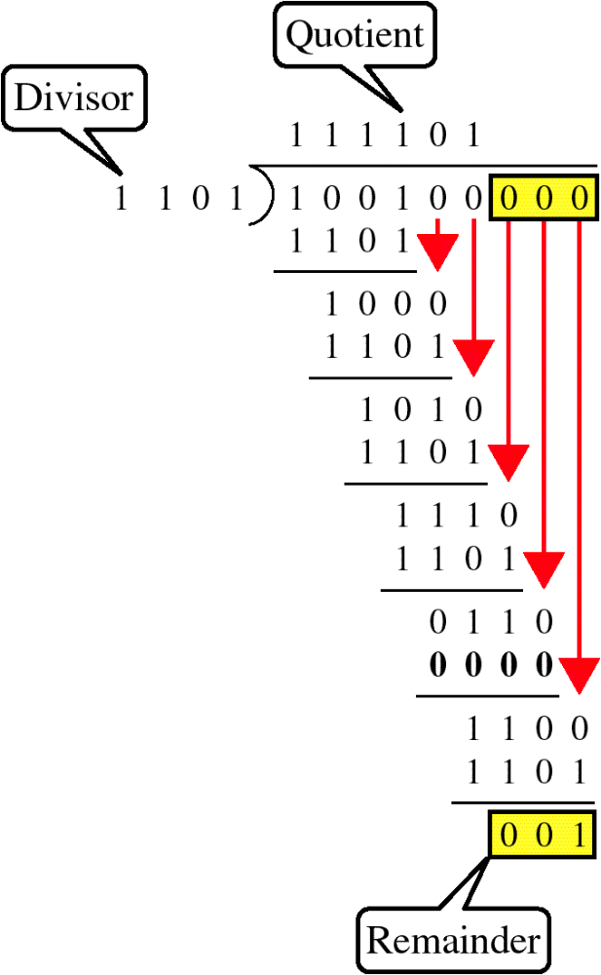
Binary Division

Slide 19
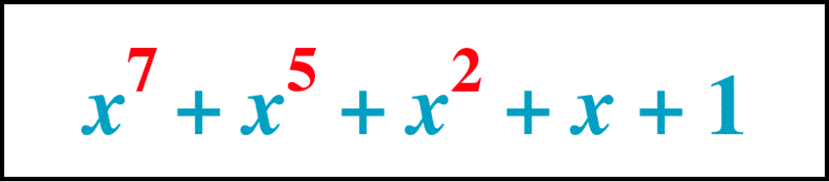
Polynomial

Slide 20
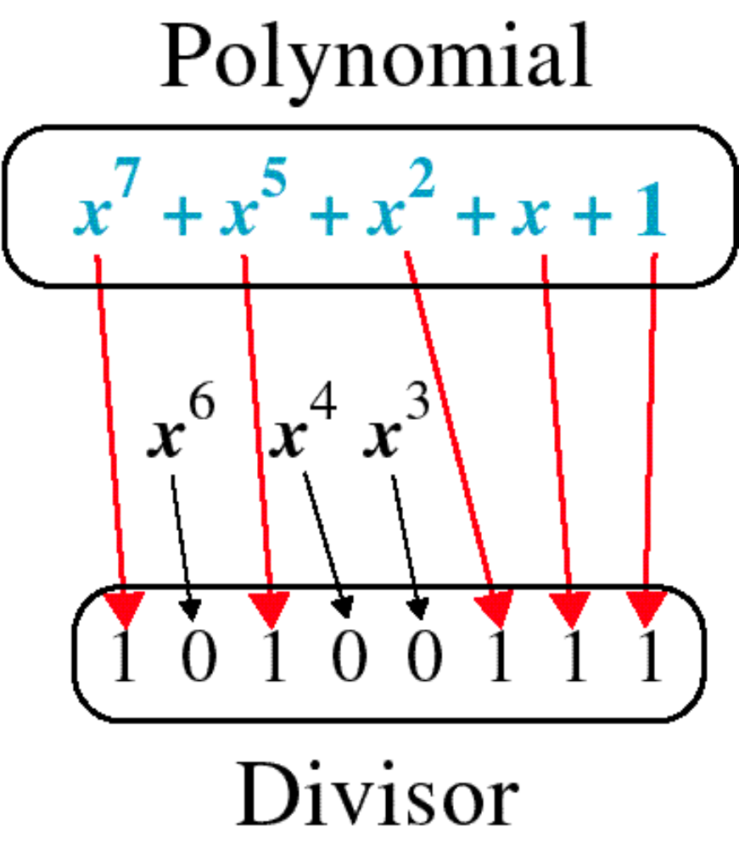
Polynomial and Divisor

Slide 21
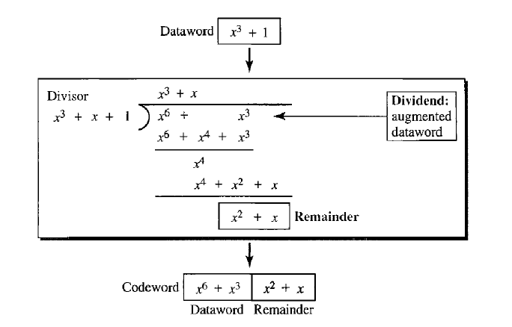

Slide 22
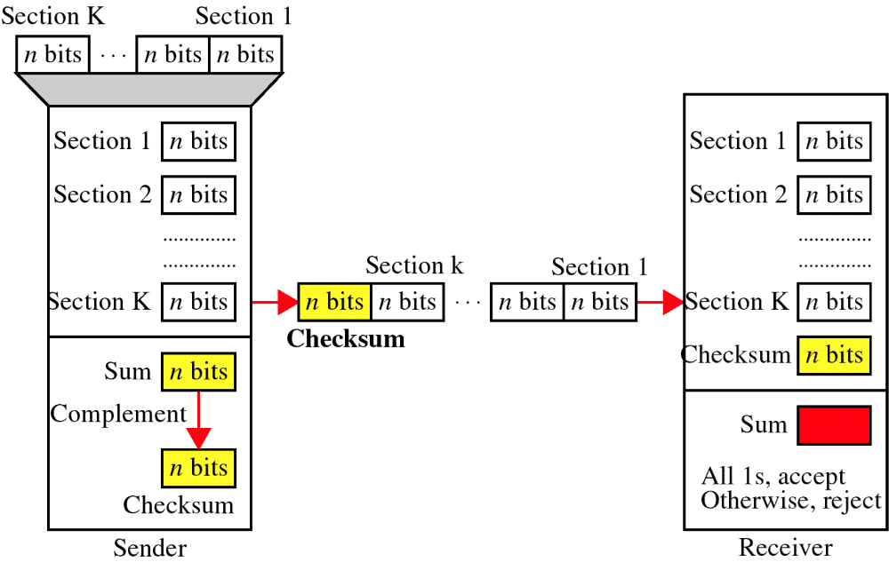
Checksum

Slide 23
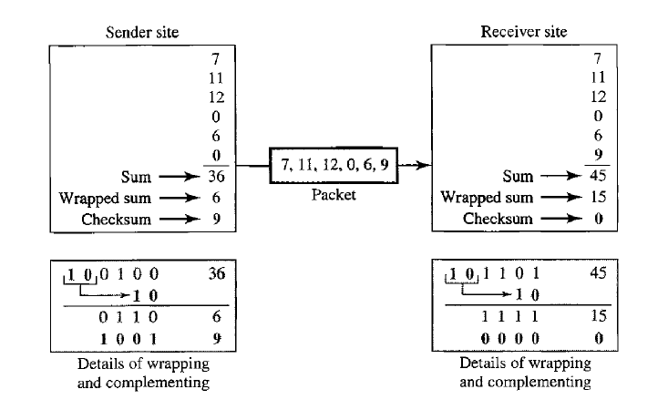

Slide 24
At the sender
The unit is divided into k sections, each of n bits.
All sections are added together using one’s complement to get the sum.
The sum is complemented and becomes the checksum.
The checksum is sent with the data

Slide 25
At the receiver
The unit is divided into k sections, each of n bits.
All sections are added together using one’s complement to get the sum.
The sum is complemented.
If the result is zero, the data are accepted: otherwise, they are rejected.

Slide 26
Error Correction
It can be handled in two ways:
receiver can have the sender retransmit the entire data unit.
The receiver can use an error-correcting code, which automatically corrects certain errors.

Slide 27
Single-bit error correction
To correct an error, the receiver reverses the value of the altered bit. To do so, it must know which bit is in error.
Number of redundancy bits needed
Let data bits = m
Redundancy bits = r
∴Total message sent = m+r
The value of r must satisfy the following relation:
2^{r} ≥ m+r+1

Slide 28
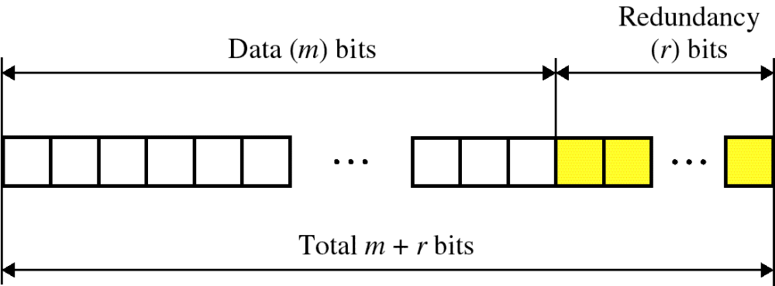
Error Correction

Slide 29
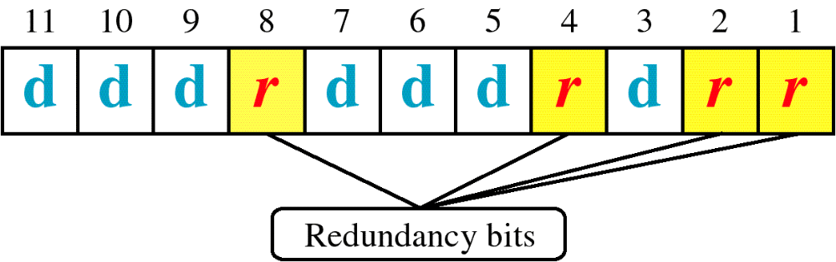
Hamming Code

Slide 30
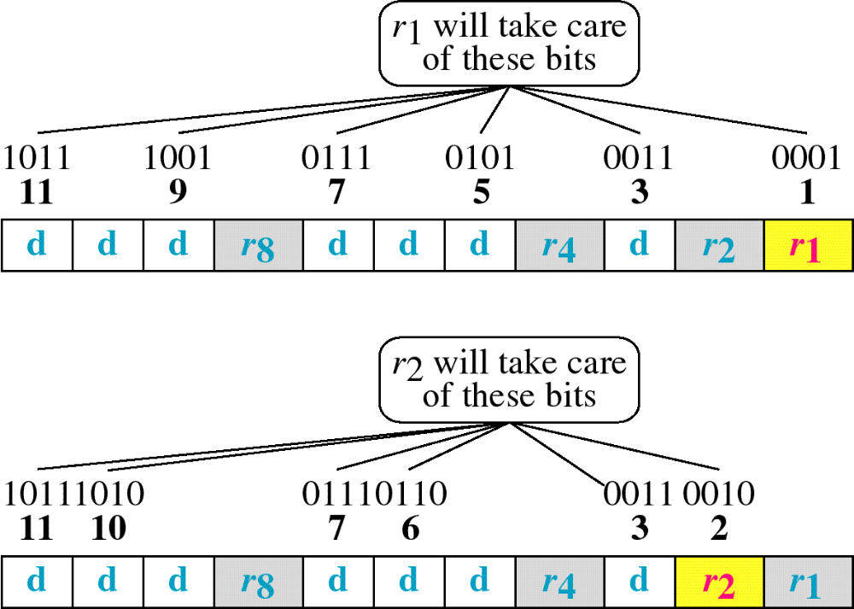
Hamming Code

Slide 31
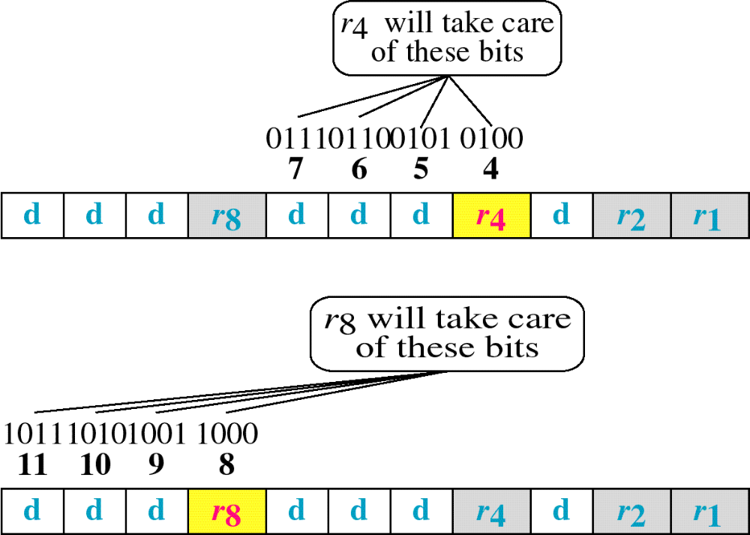
Hamming Code

Slide 32
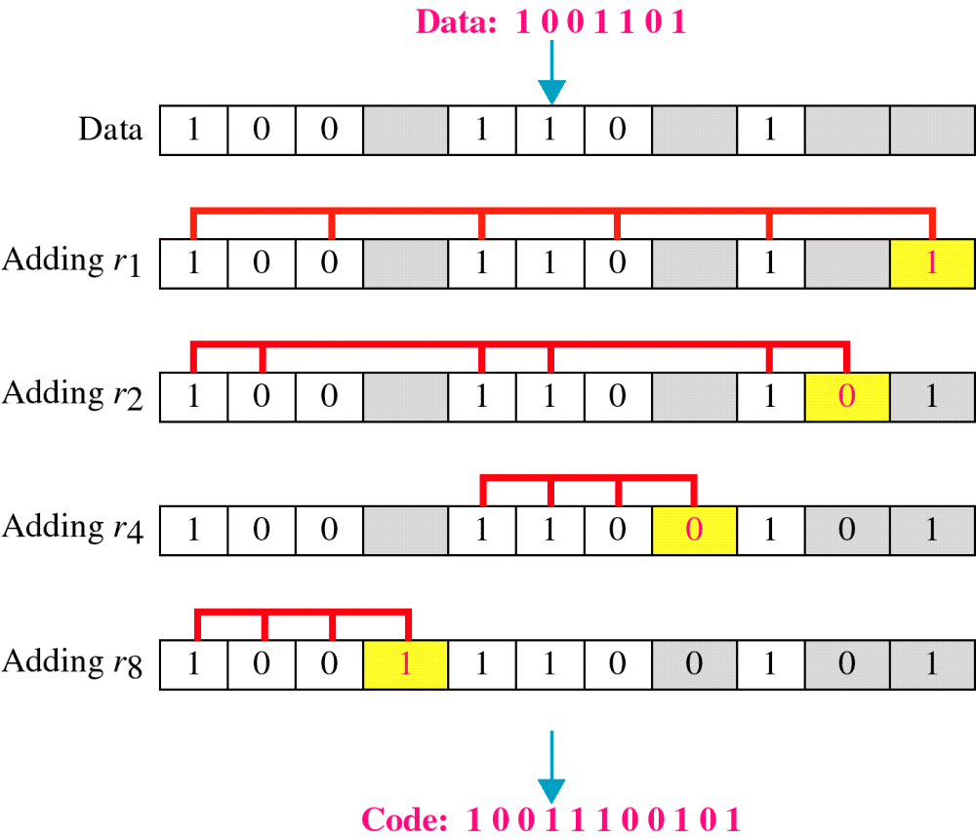
Example of Hamming Code

Slide 33
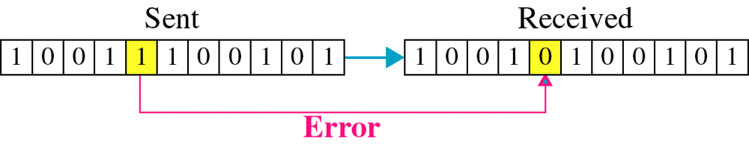
Single-bit error

Slide 34

Error
Detection

